Slide 1
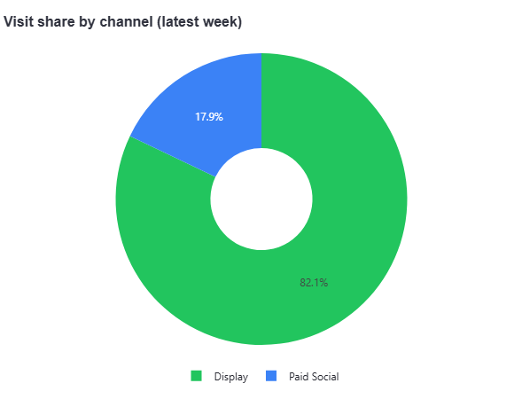
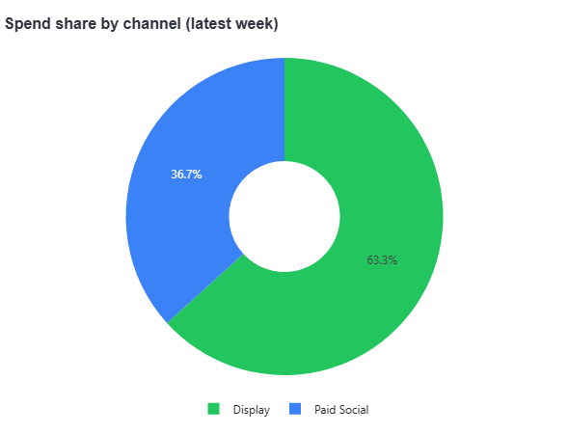
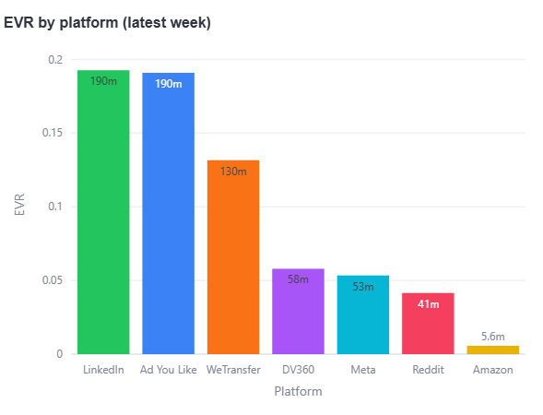
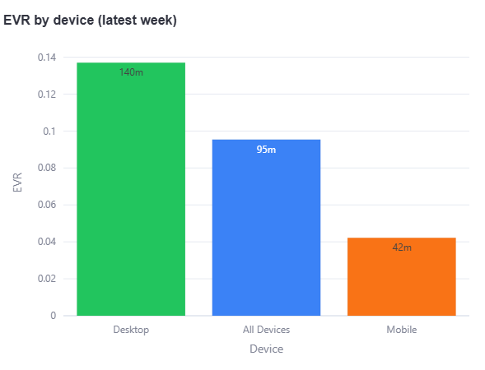
Adobe Studio Progression
Display
Paid Social
Spend
£104,313
Traffic
72,688
Engaged Visits
9,279
EVR
12.8%
CPV
£1
CPeV
£8
Spend Pacing
£66,003
Visit Pacing
59,687
EVR
13.8%
Engaged Visits
8,222
CPV
£3
CPeV
£36
Spend Pacing
£38,310
Visit Pacing
13,001
EVR
8.1%
Engaged Visits
1,057
Contributes 88.6% of this campaign’s engaged visits this week.
Engagement rate sits at 13.8%.
Cost per engaged visit is £8.
Most efficient channel by CPE is Display at £8 per engaged visit, while Paid Social is the most expensive at £36.
Contributes 11.4% of this campaign’s engaged visits this week.
Engagement rate sits at 8.1%.
Cost per engaged visit is £36.

Slide 2
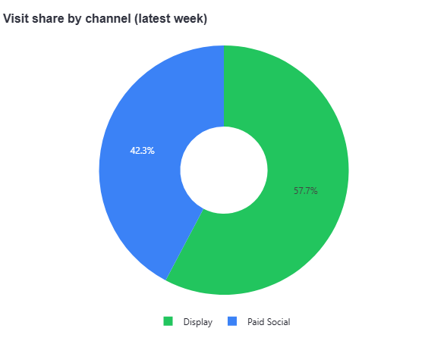
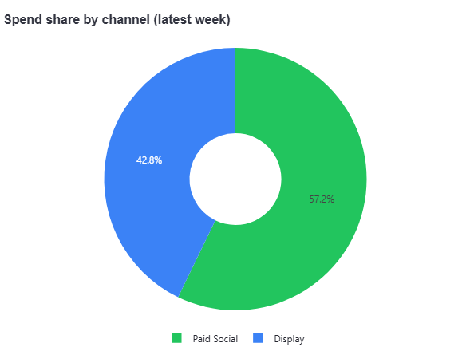
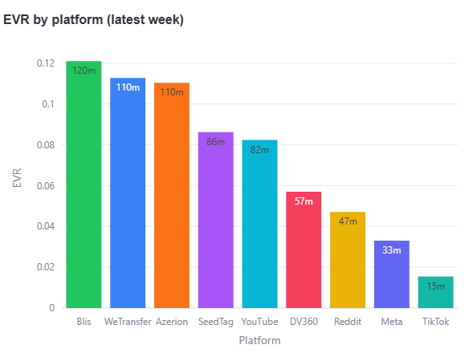
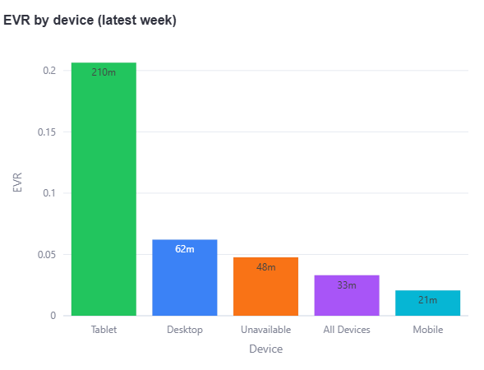
Everyone Can
Display
Paid Social
Spend
£43,427
Traffic
95,936
Engaged Visits
4,547
EVR
4.7%
CPV
£0
CPeV
£5
Spend Pacing
£18,591
Visit Pacing
55,381
EVR
6.3%
Engaged Visits
3,462
CPV
£1
CPeV
£23
Spend Pacing
£24,836
Visit Pacing
40,555
EVR
2.7%
Engaged Visits
1,085
Contributes 76.1% of this campaign’s engaged visits this week.
Engagement rate sits at 6.3%.
Cost per engaged visit is £5.
Contributes 23.9% of this campaign’s engaged visits this week.
Engagement rate sits at 2.7%.
Cost per engaged visit is £23.

